Slide 1


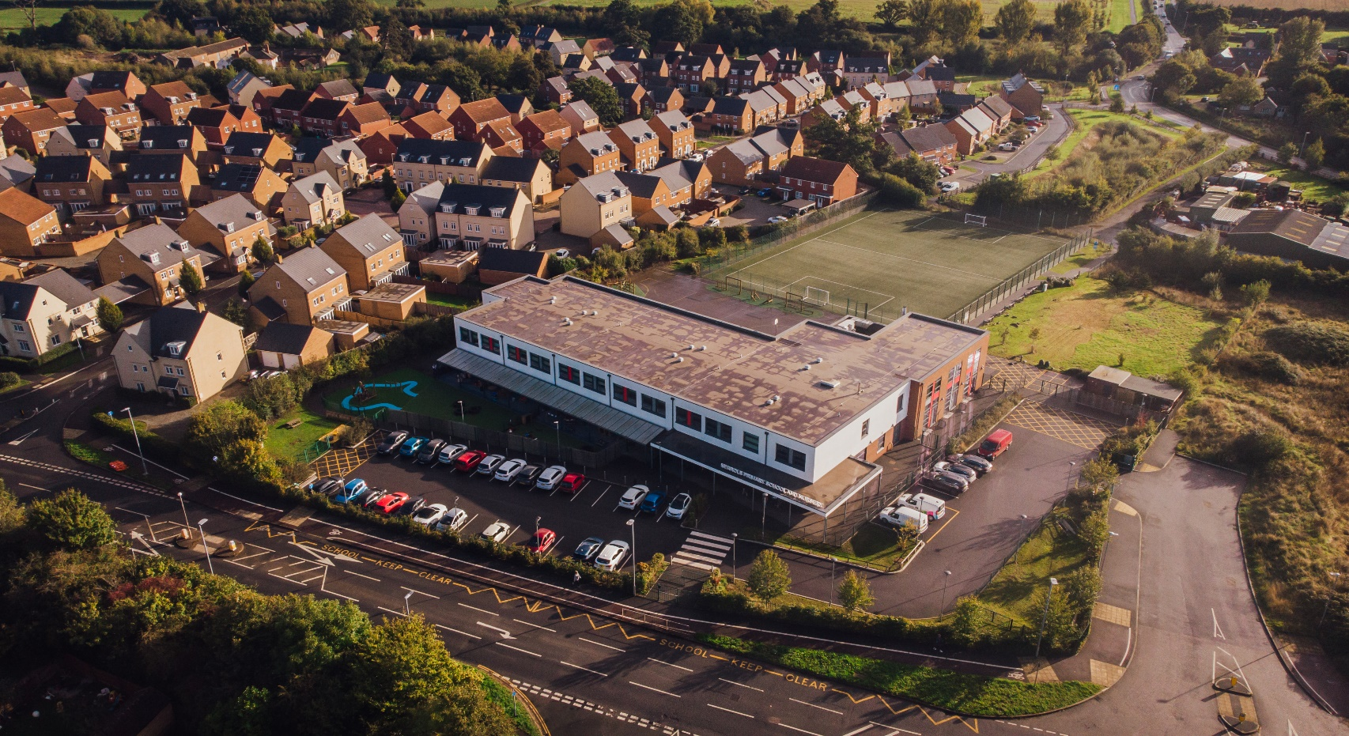
Nerrols Primary School
and Nursery
SEND Information Report
2025/2026

Slide 2
This report is designed to inform you of the types of support available for your child at Nerrols Primary School and Nursery.
It will help you understand who can help and how this help can be accessed.
This report has been co-produced with staff, parents, carers, students and governors (Summer 2025 )

Slide 3

Definition of Special Educational Needs
(taken from SEND Code of Practice: 0 to 25 years –
January 2015)
A pupil has SEN if they have a learning difficulty or disability which calls for special educational provision to be made for them. Namely provision that is different from or additional to that normally available to pupils of the same age. Making higher quality teaching normally available to the whole class is likely to mean that fewer pupils will require such support. (6.15 pg 94)

Slide 4
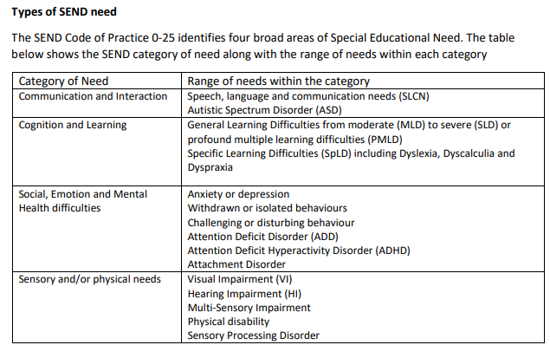
What kinds of SEND is provided for at Nerrols?
Attention Deficit Hyperactivity Disorder (ADHD) Attachment Difficulties
Self injury
Oppositional Defiance Disorder (ODD) Mental illness – depression/anxiety

Slide 5
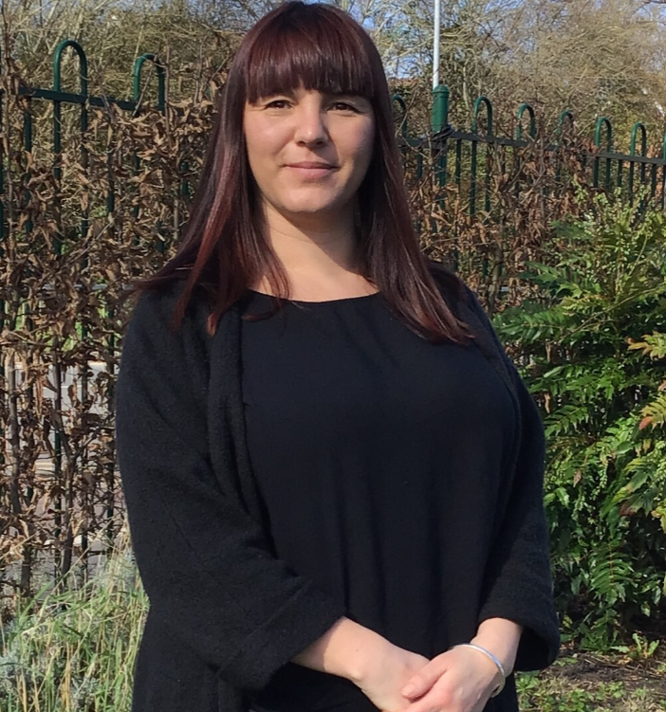

Who will coordinate SEND provision for my child?
Along with your child’s class teacher, our SENDCO’s coordinate the support and progress of any child on our SEN support list. You should know if your child is on this list.
Any additional provision/support that your child is receiving will be explained to you at parent’s evening.
Leah Challis
School SENDCO
Jo Taylor
Nursery SENDCO

Slide 6
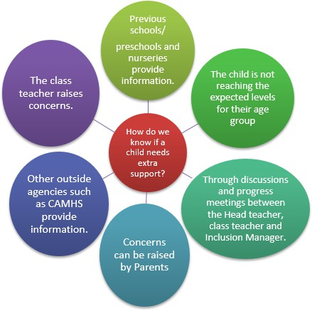
How does the school know if a child needs extra help?
Monitoring and Supporting Children at Nerrols Primary School and Nursery
At Nerrols Primary School and Nursery, we closely monitor all children through regular observation and assessment, ensuring that their progress and well-being are at the forefront. This monitoring is carried out by class teachers or key workers, who work diligently to understand each child’s individual needs.
We gather information from a variety of sources, including:
Observations and assessments in the classroom or nursery
Input from parents and carers
Information from previous settings
External agencies, where applicable
Our goal is to identify any areas where additional support may be needed as early as possible. Initially, it is the class teacher's or key worker's responsibility to meet these needs within the classroom or nursery setting. However, if they feel that the child is not making the expected progress, they will discuss their concerns with you and, if needed, consult with the Special Educational Needs and Disabilities Coordinator (SENDCo).
In some cases, further assessments may be carried out. With your consent, additional interventions might be introduced or referrals to external agencies made to ensure your child receives the best support possible.

Slide 7

How will the school’s approach be adapted to match my child’s needs?
Our Commitment to High-Quality Teaching
At our school, we are dedicated to delivering high-quality teaching that meets the diverse needs of all our pupils. Most children will follow the same curriculum as their peers, with teachers adjusting content to ensure it is accessible for every learner. To achieve this, our teachers use ongoing observation, marking, and assessment to inform their planning. This ensures that lessons are appropriately tailored to each child’s level, helping them to make progress and succeed. In practice, this might involve providing additional support or universal classroom strategies to help a child engage with a lesson. By making these adjustments, we ensure that every child is challenged and supported in their learning journey.

Slide 8
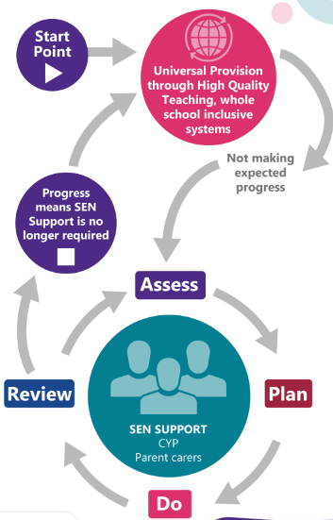
How will the school initially support my child if they need extra help?
Supporting Your Child’s Learning
Your child’s teacher or key worker is primarily responsible for their education. If your child is identified as needing extra support, this will be addressed first through in-class strategies. These universal strategies may include:
Planning and providing more individualised activities
Adapting whole-class lessons to suit their needs
Offering access to additional resources or support to ensure your child can engage with the learning
Teachers and key workers follow a consistent approach for all children who need extra support.
This is the initial stage of a process known as the Assess, Plan, Do, Review (APDR) cycle, ensuring that your child’s progress is continuously monitored, and adjustments are made as needed.

Slide 9
High Needs Support
This support is provided for a small number of the highest needs children. It may include specialist input from external professionals such as the TDPC, paediatricians or educational psychologists. Additional support could also involve 1:1 LSA support to enable access to education, as well as comprehensive support for physical, communication, SEMH or sensory needs. At this stage, an Education, Health and Care Needs Assessment (EHCNA) might be considered.
Universal Provision
This is available to all/most children and may include: adaptations to tasks or activities, a range of recording methods, additional learning resources e.g. concrete maths equipment, word or vocabulary mats, seating plans, movement breaks, wobble cushions, fidgets or visual timetables. Group interventions or support may be offered such as ELSA, Forest School, Talkabout or Rapid Maths/Writing.
SEND Support
Targeted support at this level is available to some children. It may include: an individual support plan, 1:1 academic or SEMH interventions, individual timetables or planning, now & next, sensory, SALT or OT plans or advice needing a significant level of input or adaption. Referrals to external professionals such as SALT, OT or ND Pathway may be made at this stage.
What type of support or provision may be provided for my child at each level of SEND support?

Slide 10

How are resources allocated and matched to my child’s needs?
At Nerrols, we are committed to supporting all children with additional needs to the best of our ability, using the available resources. We firmly believe that all teachers are responsible for every child in their class. Wherever possible, teachers provide additional support through adaptive and inclusive learning opportunities within the classroom.
We also have a team of Learning Support Assistants (LSAs), partially funded by the SEN budget, who work alongside teachers to support individuals and small groups, through classroom support, and 1:1 or small group activities. For some children, specialist equipment or facilities may be necessary.
A small number of children, with Educational Health and Care Plans (EHCP) may qualify for top-up funding, which enables the school to provide additional resources and support tailored to their needs.

Slide 11
How will I know how my child is doing?
The school uses termly assessments to track each child's progress in core subjects. Additional support and interventions are also monitored for their impact. Parents’ meetings are held in the Autumn and Spring terms for all children, and the SENDCo may attend these meetings upon request of the teacher or the parent/carers. End-of-year reports are sent home in the Summer term, when meetings with the class teacher and SENDCo can also be requested.
Children with complex needs or an Education, Health and Care Plan (Education, Health and Care plans (somerset.gov.uk) will have an Annual Review meeting to discuss their progress and plan their next steps. Every child receiving SEND support also has an Individual Support Plan, which outlines their APDR (Assess, Plan, Do, Review) cycle. These plans are reviewed and shared each term, and parents are encouraged to provide feedback.

Slide 12
How will Nerrols support my
child’s Mental Health & Wellbeing?
At Nerrols Primary School and Nursery, we are dedicated to supporting the mental health and wellbeing of all our children. Through our curriculum and universal provision, we help children understand and explore their emotions and wellbeing. If you have any concerns about your child’s mental health, your first point of contact will be their class teacher or key worker.
Personal, Social, and Health Education (PSHE) offers opportunities for children to learn how to care for their own wellbeing. We also offer a variety of lunchtime and after-school clubs that support social and personal development, some of which are by invitation, while others are open to all.
For children who need more individualised support, the school provides access to a range of mental health resources, including our Emotional Literacy Support Assistant (ELSA), social communication support, and referrals to specialist services such as the Mental Health Support Team (MHST) and the Child and Adolescent Mental Health Services (CAMHS).

Slide 13
Emotional Literacy Support Assistant (ELSA)
An Emotional Literacy Support Assistant (ELSA) is a trained, school-based learning support assistant. Their role is to support the emotional wellbeing of pupils. They are trained by educational psychologists and receive ongoing group supervision.
Who do ELSAs work with?
ELSAs work with children either individually or in small groups and deliver bespoke interventions tailored to the situation or needs of the child/ren. The role of the ELSA is to develop children and young peoples’:
emotional literacy
positive mental health
social skills
emotional wellbeing
ELSA’s receive training and supervision to support children needing support in the following areas:
emotional literacy including building resilience and self-esteem
managing emotions including anger and anxiety
social and friendship skills
loss, bereavement and family break-up

Slide 14


Mental Health Support in Schools Team
What are the Mental Health Support Teams (MHSTs)?
The Mental Health Support Teams (MHSTs) in Somerset are a partnership between Young Somerset and Somerset CAMHS (Child and Adolescent Mental Health Services).
The MHST work in educational settings across the county, supporting children and young people aged 5-16 with their mental health and wellbeing. MHST’s primary goal is to ensure that children, young people and their families receive timely help when they need it. Additionally, they aim to build resilience by equipping children, young people and their families with tools and strategies to use now and in the future.
MHST provide support for mild to moderate mental health concerns through Low Intensity-Cognitive Behavioural Therapy (LI-CBT). MHST will discuss LI-CBT is most effective when mental health changes first begin to emerge. Support for younger children is normally provided through parent lead CBT enable them to support their children. For older children MHST may choose to work directly with students.
Referrals can be made via the SENDCo’s termly consultation meetings with MHST.
Referrals will then be triaged by the MHST team and if the referral is successful children will be added to the waiting list.

Slide 15

What specialist services might be available to support my child?
The staff team at Nerrols Primary School and Nursery have considerable experience supporting children with dyslexia, autistic spectrum condition, ADHD, social and emotional difficulties, speech and language difficulties, general learning difficulties and physical/sensory needs.
When needed we can seek advice from services such as:
Children and Young People’s Therapy Service (including Speech & Language Therapists,
Occupational Therapists, etc)
Local Authority Advisory Teachers from Access to Inclusion, Ethnic Minority Achievement Service (EMAS)
Taunton Deane Partnership College - outreach service for SEMH needs (Social, Emotional and Mental Health)
Educational Psychology Service (EPS) (this is a service buy-in service, access to EP service is currently strictly limited)
limited)
Child and Adolescent Mental Health Service (CAMHS)
Education Safeguarding Service (ESS)

Slide 16

What support does Nerrols Primary School and Nursery have for a parents including parents of children with SEND?
Your child’s class teacher and SENDCo will be happy to discuss the support offered by the school for parents and carers.
We can also signpost and/or refer you to other specialist support services such as…
Home (somersetsend.org.uk) SENDIAS
Somerset’s SEND Local Offer The SEND Local Offer
Family Intervention Service (somerset.gov.uk) FIS
Children - The Sleep Charity – Sleep support

Slide 17

Is there anyone else who might work with my child?
A range of outside professionals may be consulted to provide support or advice to help us to meet your child’s needs. This may include
For further information on the services available, please look at the Somerset Local Offer website: Somerset’s SEND Local Offer

Slide 18
What training is made available to staff supporting children with SEND?
All staff have regular training opportunities to support the children at Nerrols Primary School and Nursery including those with SEND. The focus of training is regularly reviewed according to the needs of the children and the school’s priorities for improvement.
All adults who work with individuals or groups of children receive the necessary support or training to deliver the sessions. These sessions are overseen by the class teacher and the SENDCo to monitor the progress of the children. The extent and level of training/support provided depends on the nature of a child’s needs and the provision needed.

Slide 19


How will my child be included in activities outside of the classroom?
Students with SEND are supported and encouraged to be fully involved in all aspects of school life. Individual arrangements (and risk assessments if necessary) are planned in advance to ensure they can be appropriately included on trips, offsite activities and extra-curricular events.
For students who are unable to participate in the usual sporting activities, appropriate adaptations will be made whenever possible to ensure that all children can engage in inclusive and suitably challenging physical activities.

Slide 20


How will my child and I be involved in decision making and planning for their education?
For parents/carers
Parent meetings with class teachers
Parent meetings with SENDCO and/or class teacher if appropriate
SEND reviews / EHCP annual reviews
Home visits as part of reception entry transition
School Entry Plans – for children with early years funding or support
Phone calls home
Open door policy
EHCP annual reviews
For children:
Pupil voice surveys
1:1 conversations
Input into individual support plans
Through getting to know your child

Slide 21

How will the school support my child’s transition to a new setting?
Prior to starting in Reception, children identified as having SEND will have a School Entry Planning meeting. This will be attended by parent/carers, pre-school staff, school staff and any external professionals involved in supporting your child. An action plan is devised to make the transition to school as smooth as possible. Where it is thought appropriate the Nerrols staff, will also visit pre-schools to meet the children in a familiar setting. All children will be invited to attend settling-in sessions to ensure they are familiar with the staff and the setting in advance. Home visits are carried out in the Autumn term by our Reception class teachers and teaching assistants.
When moving to Secondary School, children with additional needs are discussed with the SENDCo at the secondary School once places have been allocated. Additional visits can be organised by the secondary school. If your child has complex needs and has an Education Health Care Plan, an Annual Review meeting will take place in the Summer term of Year 5 or the Autumn term of Year 6 to ensure the Local Authority has the information needed to update the child’s Education Health Care Plan and consult with possible secondary schools.

Slide 22

Who should I contact for more information or if I am concerned about my child?
Speak to your child’s teacher in the first instance. They are available for an informal chat in the mornings and afternoons. For a more formal conversation, an appointment can be made with via the school office.
If following this meeting, you would then like to meet with the SENDCo please approach the school office to arrange a meeting.
If you feel you need further support, please make an appointment with the Headteacher to discuss your concerns.
If you still have concerns, you may contact our Chair of Governors via the school office.

Slide 23
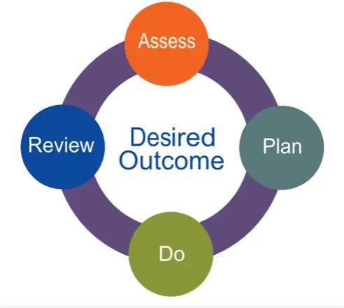
How will the school advise me if they have concerns about my child?
If we have concerns about any aspect of your child’s school life, the most appropriate member of staff will contact you. This may be your child’s class teacher or a member of the school’s Senior Leadership Team.
Staff may also use other opportunities such as your child’s school report, Individual APDR, annual or individual support plan reviews or parents evening to let you know about any concerns.
In line with the SEND Code of Practice, we will always inform parents/carers if special educational provision is being put in place for your child and they are being placed on the school’s SEND register.

Slide 24
Who has contributed to this report?
Signed on behalf of the senior leadership team:
M Kerton (Head teacher)
L Challis (SENDCo)
This report was presented to and approved by the school’s Senior Leadership Team in Summer 2025
Signed on behalf of the Governing Body:
Wendy Deveraux
(Chair of the Governing Body)
(SEND Governor)
This report was presented to and approved by the school’s Governing Body

Slide 25

Who has contributed to this report?
A big thank you to the children, parents, carers, external professionals and staff who were consulted on this report during the academic year 2024-2025

Slide 26
SEND Glossary
ADHD (Attention Deficit Hyperactivity Disorder)
A condition affecting concentration, impulse control, and activity levels. Pupils may need support with focus, behaviour, and organisation.
ASC / ASD (Autism Spectrum Condition / Disorder)
A neurodevelopmental condition that affects communication,
social interaction, and flexibility of thought. Often referred to as ASC in UK schools.
Annual Review
A yearly meeting to review the progress and needs of a pupil with an EHCP (see below), and to consider whether any changes are needed.
CAMHS (Child and Adolescent Mental Health Services)
NHS services supporting children and young people with emotional, behavioural or mental health difficulties.
Differentiation/Adaption
Adapting teaching methods, tasks or resources to suit the individual needs of learners.
EHCP (Education, Health and Care Plan)
A legal document for children with significant and complex needs. It sets out the support a child requires across education, health and social care.
EHCNA (Education, Health and Care Needs Assessment)
The formal assessment process carried out by the local authority to determine whether a child or young person requires an Education, Health and Care Plan (EHCP).
EAL (English as an Additional Language)
Used for pupils whose first language is not English. EAL is not a SEND category but may overlap with other needs.
EP (Educational Psychologist)
A specialist who assesses children’s learning and behaviour needs and advises schools on support strategies.
EPPLAC
Education and Personal Progress Plan for Looked After Children.
Graduated Response
A four-part cycle (Assess, Plan, Do, Review) used by schools to provide increasingly targeted support for children with SEND.
IEP/ISP (Individual Education or Support Plan)
A document that outlines specific, short-term targets and strategies for a child with SEND
Inclusion
Ensuring all children, regardless of ability or need, are welcomed, valued and supported to take part fully in school life.
Intervention
A specific programme or additional support, usually time-limited, designed to help a child progress in a particular area.
Key Person / Key Adult
An adult in school who has a close, supportive relationship with a child, often used to provide consistency and emotional support.
LSA or TA (Learning Support or Teaching Assistant)
A staff member who supports children with learning needs, usually in class or in small group interventions.
MHST (Mental Health in Schools Support Team)
providing early intervention and preventative mental health support for children and young people in educational settings.
Occupational Therapy (OT)
A service that supports children who have difficulties with everyday physical tasks, such as handwriting, balance, or coordination.
Pastoral Support
Support for children’s emotional, social, and behavioural needs, often led by a pastoral team or key worker.
PEP (Personal Education Plan)
A plan required for every child in care (Looked After Child), outlining education targets and support.
Provision Map
A document that outlines all the additional support provided in a school for pupils with SEND.
Reasonable Adjustments
Changes made to remove or reduce barriers for pupils with disabilities, as required by the Equality Act 2010.
SALT (Speech and Language Therapy)
A service supporting children with speech, language, and communication difficulties.
SEMH (Social, Emotional and Mental Health needs)
A category of SEND where children experience difficulties managing emotions, behaviour or mental health.
SENCo (Special Educational Needs Coordinator)
The teacher responsible for coordinating SEND support within a school.
SEND Code of Practice
The statutory guidance that schools and local authorities
must follow in identifying and supporting children with SEND.
SEN / SEND Support
The level of support provided for pupils with SEND who do not have an EHCP but require extra help to meet their needs.
Sensory Processing Difficulties
When a child struggles to interpret or respond appropriately to sensory information (e.g. sound, touch, movement).
TAF / TAC (Team Around the Family or Team Around the Child)
A multi-agency approach involving professionals and family members to support a child’s wider needs.

