Slide 1

Year 5 and 6 Expectations Meeting
September 2025

Slide 2
Meet the team!
Class Teachers:
Year 5: Miss Rapsey
Year 6: Mrs Gavins
Learning Support Assistant(s):
Year 5: Mrs Traynor
Year 6: Miss Lenga
The children will be taught by Miss Collins for RE and by Mr Templeton for PE and Sport as part of the teachers’ planning, preparation and assessment time.
Year 5 – Friday Year 6 – Friday

Slide 3
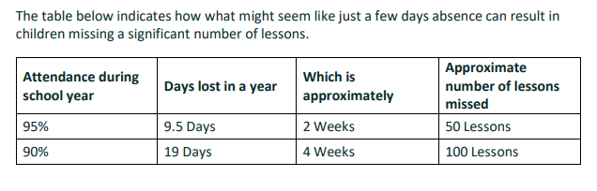
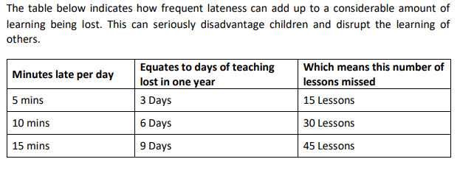
Attendance and punctuality
We expect children to attend school every day, unless they are really not well enough to.
We believe that children who attend school regularly are more likely to feel settled in school, maintain friendships, keep up with their learning and gain the greatest benefit from their education.
Please make sure that your child is in school on time (by 8:45am) so that they can start their school day along with their peers.
Notes:
Soft Start

Slide 4
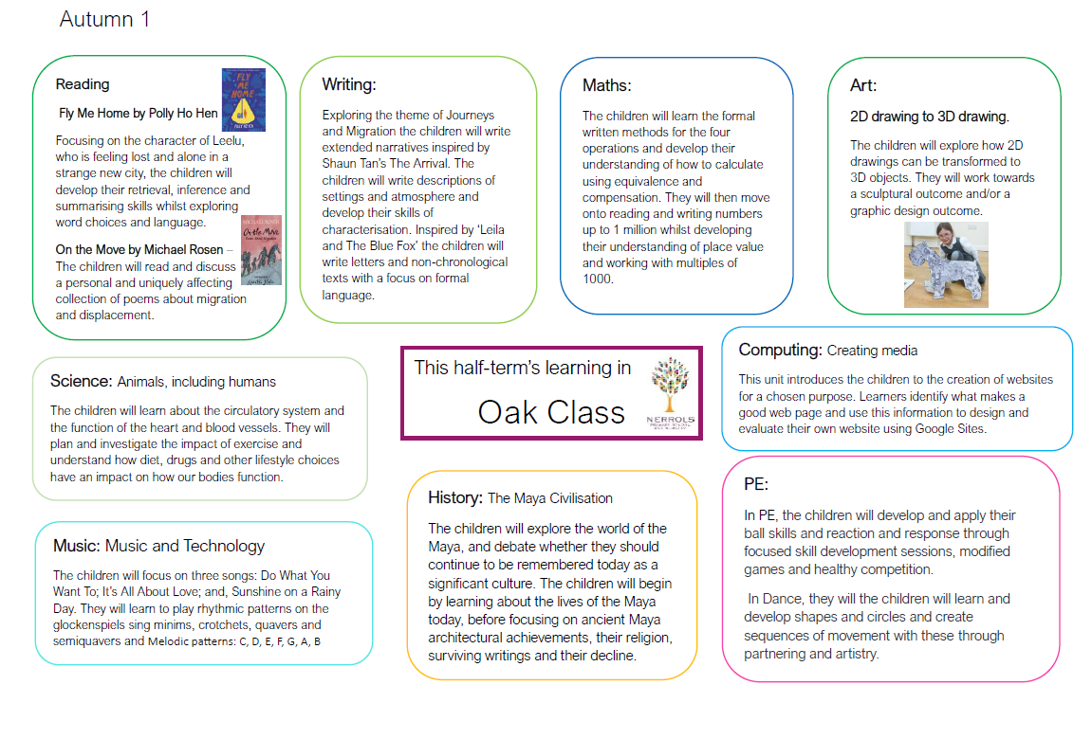
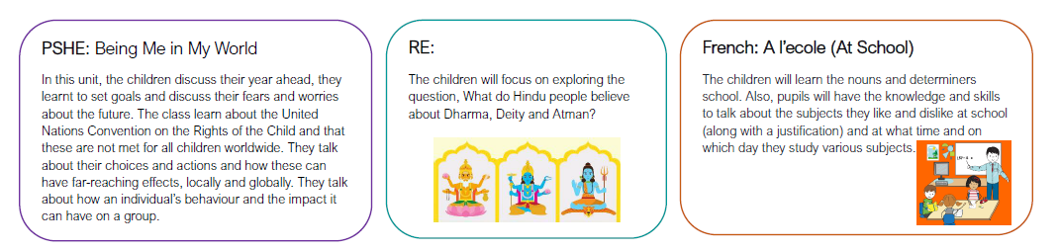
Curriculum Overviews
To enable parents to understand what their children are learning in school, a curriculum overview document will be sent home each half-term via MCAS.
There will be a short description about each subject and may include important vocabulary, key questions or focus artists.

Slide 5

The importance of reading
We can’t stress enough the importance of your child learning to read.
It has been proven that children who read more and become good readers make better academic progress at school and beyond.
Reading is necessary to access all areas of the curriculum.
Importantly, children who read have three times better mental wellbeing than their peers who don’t. Reading is relaxing and offers time away from hectic modern lives.

Slide 6
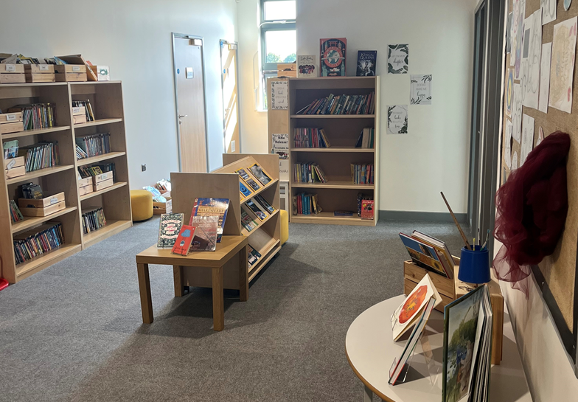
Reading
At Nerrols, we are passionate about creating a lifelong love of reading and giving children the skills they need to become confident and competent readers.
The children may change their books as often as they require.
They will have a book band book and a library book. If they are free readers, they will have one book.
The children will be bench marked at the end of each full term.

Slide 7

Developing a love of reading
Ensure that reading has a high profile in your home and is seen as important.
Make your own reading visible to your child.
Make time for reading every day.
Make reading part of the bedtime routine for your child.
Be enthusiastic about reading to your child. Show them that you really look forward to it.
Read lots of different books and read the same story time and time again if they ask for it!
Talk about the books with your child. Who is their favourite character? Which was their best part? What might happen next? What is happening in the picture?
Join the library and ask the librarians for advice about books.

Slide 8



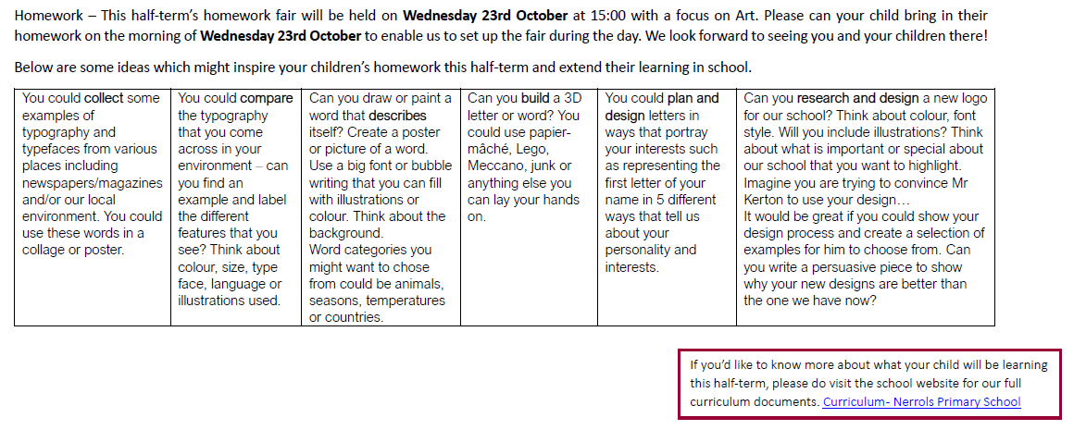
Homework
At Nerrols, we believe that homework is an opportunity for children to consolidate and develop fluency in their learning. It enables children to develop inquiry skills and lead discussion. The homework suggested by teachers is linked to learning which has recently taken place in the classroom – it is an integral part of learning, rather than an add-on.
In Hazel Class, children will receive spelling and My Maths homework every week and will be encouraged to practise times tables on TT Rockstars.
In Oak Class, children will receive spelling and either My Maths or maths revision and will be encouraged to practise times tables on TTRockstars.
As the year progresses, reading and grammar revision may also be sent home to support their learning in class.
As part of the half-termly curriculum overviews, we will be holding a fair each term linked to different subjects. We hope to promote opportunities for children to demonstrate their knowledge, areas of interest in a subject and for their parents/carers to be involved in discussion around different topics.
Homework will be set on a Monday and spelling quizzes will happen on the following Monday.
Notes:
Parents will be invited to attend the fair to celebrate and explore the range and depth of children’s extended learning across the school. This will encourage children’s intrinsic motivation to extend their learning beyond the classroom. Homework will therefore not be rewarded in the traditional methods such as by receiving house points. Similarly, it will not be ‘marked’ by class teachers.

Slide 9
Reading Homework
We teach reading five times a week and we read to our classes five times per week. Our expectation is that they also read their phonics or book band book at home, with an adult, five times per week (or more). We know that lots of our children also enjoy being read to daily.
When you read with your child, please add a comment in their Reading Record. This could refer to any words they found challenging, questions you asked them and their responses or what they are enjoying about their book. Our staff will look at Reading Logs every day and it is vital that we work together to help our children to read.
We would really appreciate your support in upholding our expectation of your child reading their phonics or book band book five times a week. In addition, they will bring home a library book which they may need read to them.

Slide 10
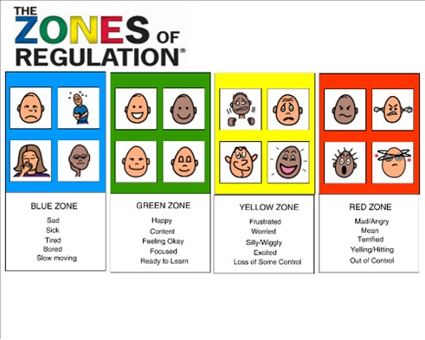
Zones of Regulation
We believe that the children’s emotional wellbeing is extremely important.
We use Zones of Regulation to encourage the children to talk about their feelings and indicate how they are feeling.

Slide 11
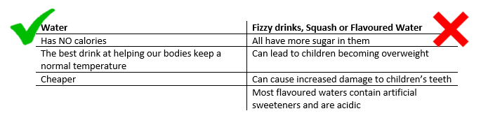
Water bottles
Our children are, of course, allowed to drink from their water bottle throughout lesson time. We are aware of the health benefits of regularly drinking water and recognise that children who are well-hydrated find it easier to concentrate on their learning and to work hard.
Children’s water bottles are kept at the side of their classroom and not on their desks. This is because it helps to maintain concentration and focus and so they do not spill their water and spoil their work.
We expect our children to actively listen to their teacher, or those who are speaking, and so are not allowed to leave their seat for a drink during such time. There might be the odd occasion when children are not allowed to drink from their bottle if they try to at an inappropriate time, however this will only be for that small amount of time and does not mean they are ‘not allowed to drink water’.
We also encourage our children to use our water fountains at break and lunchtimes and to help themselves to water in the Lunch Hall, which is always available via the jugs and cups placed on their tables.

Slide 12
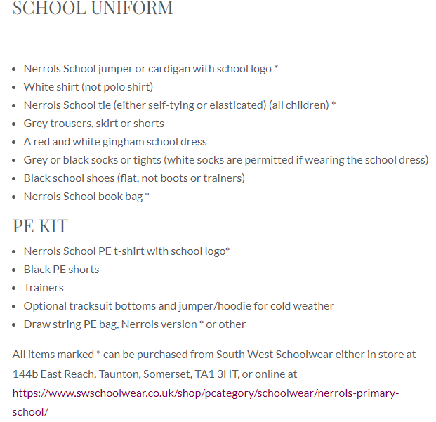
General
PE Kits – please bring in on a Monday and children will bring home with them on Friday. Our PE lessons will take place on Friday.
Book bags, water bottles and coats in every day please.
Can children please bring wellies into school to use during their play.
Please ensure all clothing items are labelled so they can be easily returned if they get lost.
Notes:
And one other day TBC

Slide 13


